Slide 1
My Store Analysis
Aly, Chloe, Jack, Rachel

Slide 2
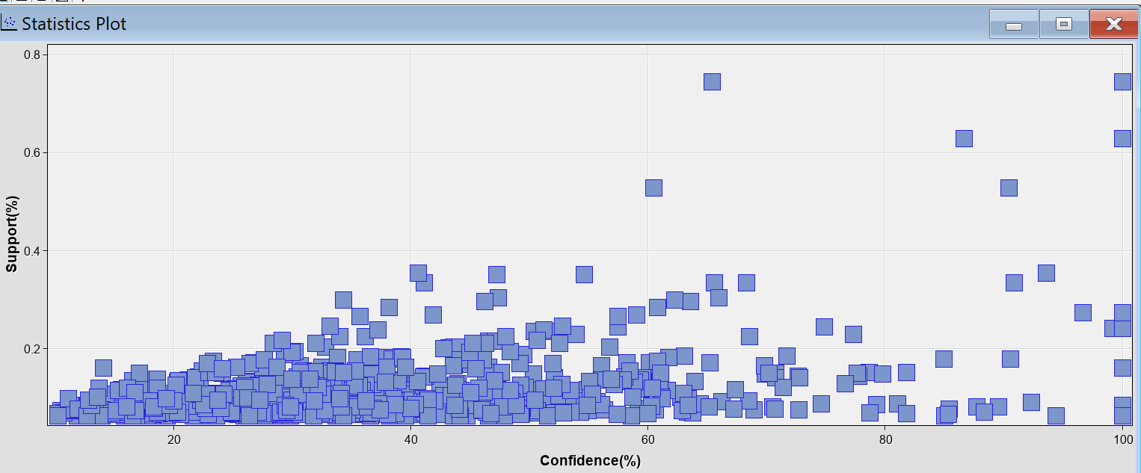
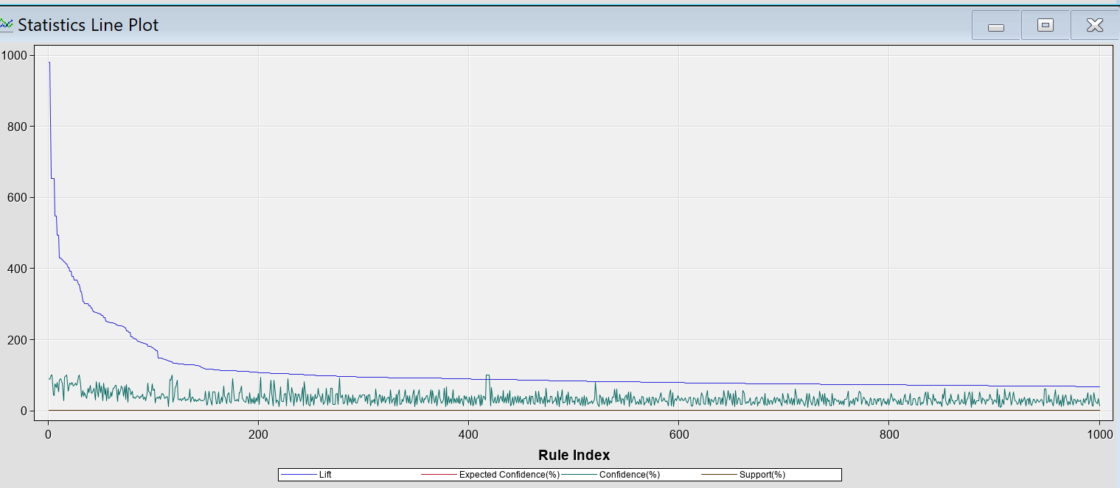
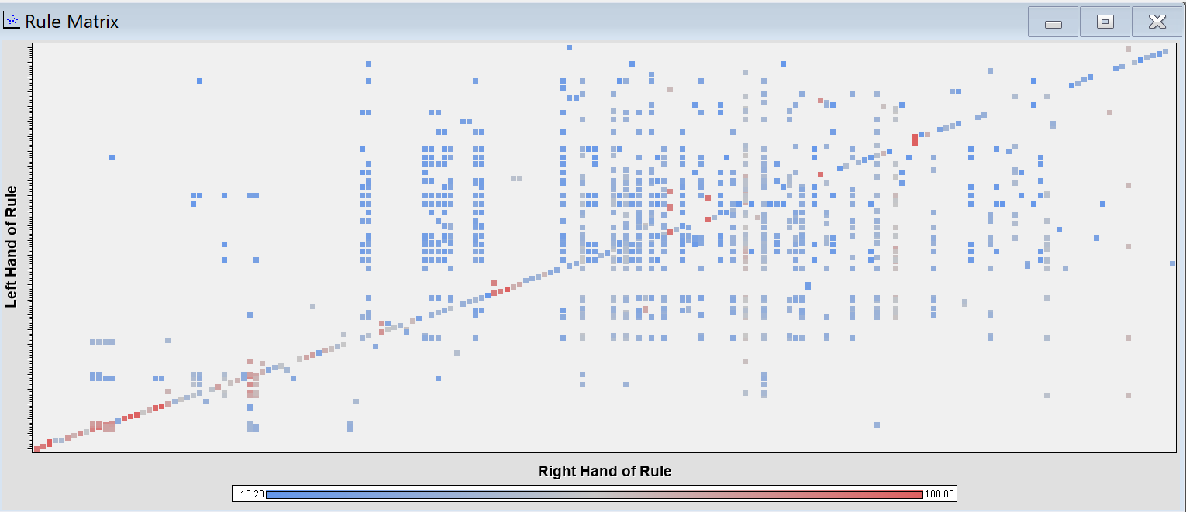
Association Analysis MyStore

Slide 3
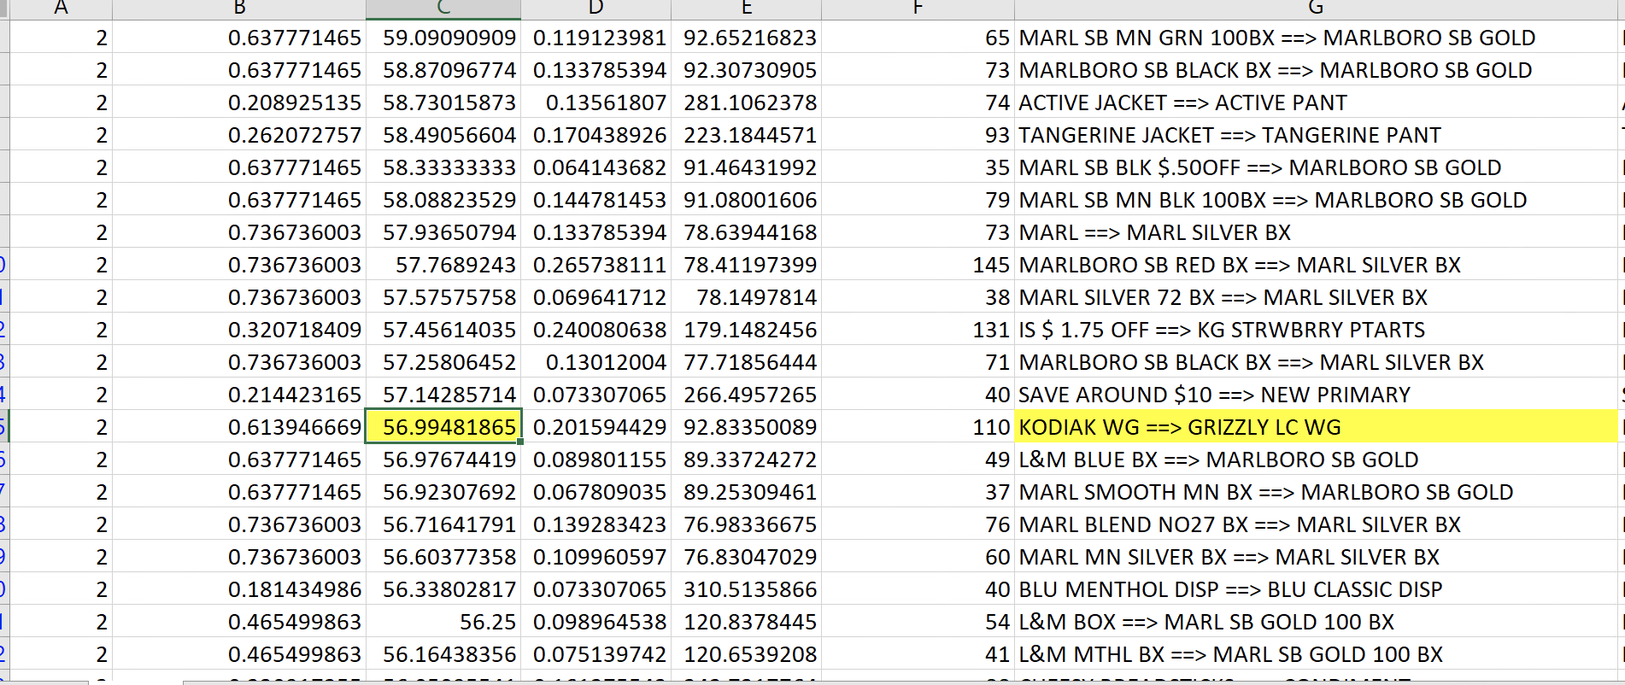
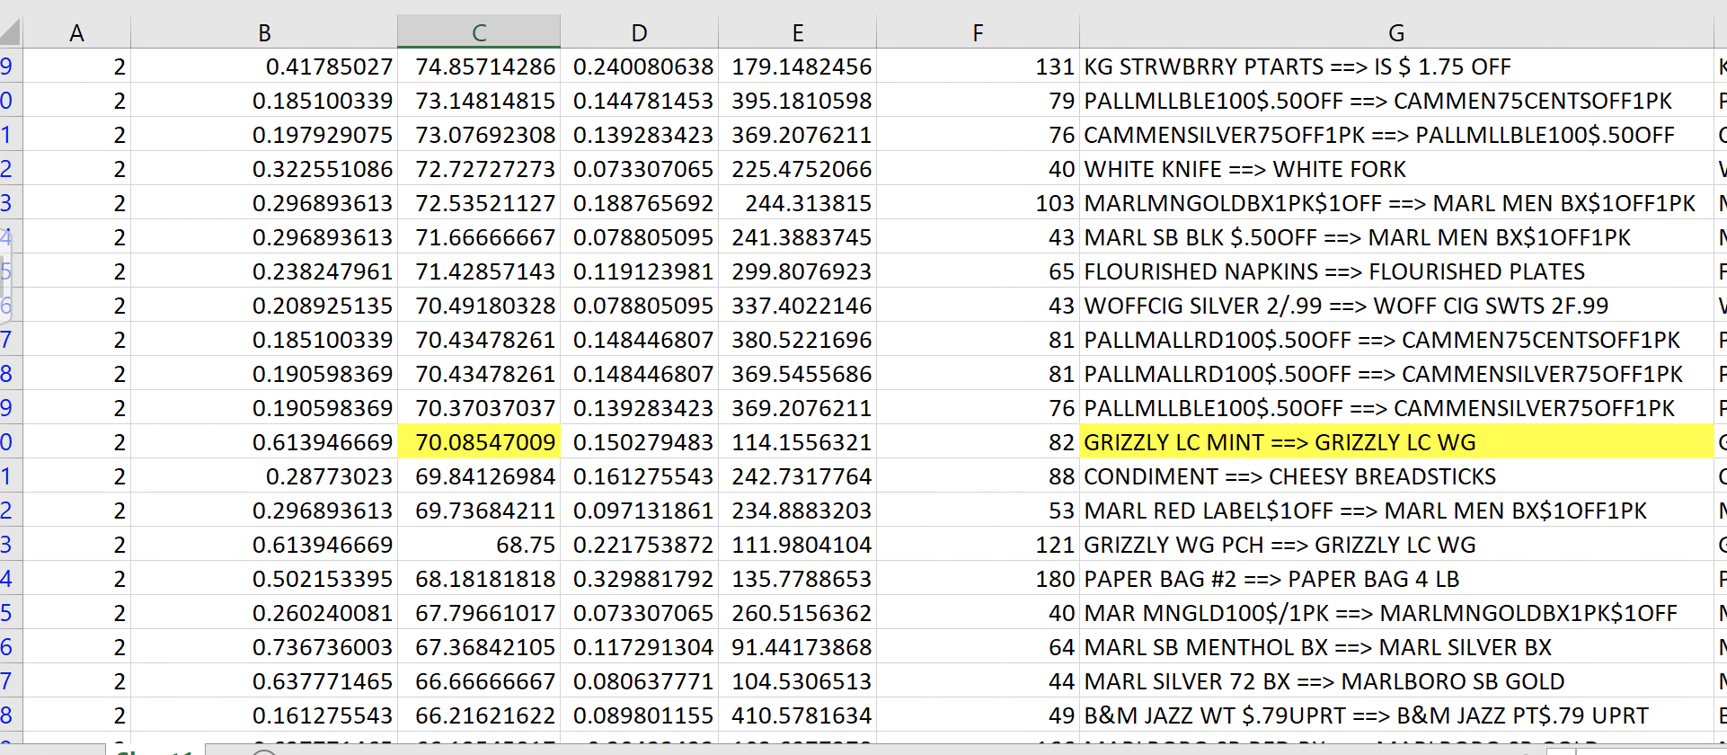
Association Analysis Findings
About 57% of the time, a customer who bought Kodiak smokeless tobacco, also bought Grizzly smokeless tobacco
About 70% of the time, a customer who bought Grizzly mint, also bought Grizzly wintergreen
As a result, the store manager should put the items with a strong association next to each other, making it easy for the customer to find.

Slide 4
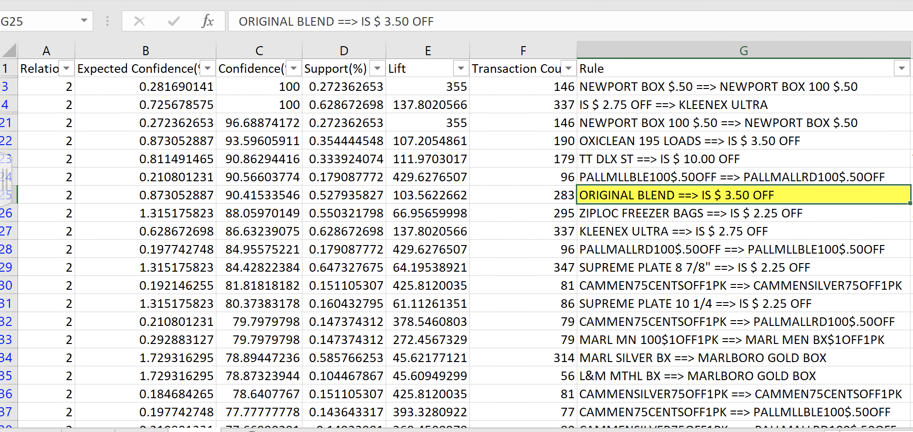
Association Analysis Findings (cont.)
Looking at many of the high confidence intervals, a coupon was used.
For example, 90.42% of the time, when someone purchased Original Blend, it was with a $3.50 coupon.
As a result, the store manager should continue to provide these coupons.

Slide 5
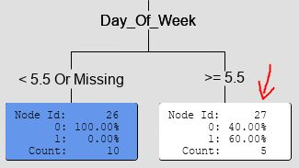
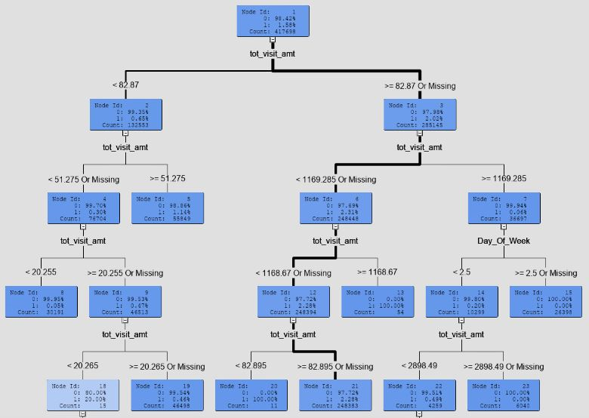
Decision Tree
Classification was only wrong about 1.6% of the time, but this was essentially equal to the amount of carts containing beer
The strongest path did not use the Day_of_Week variable - 97.7% of purchases between $82.90 and $ 1,168.7 did not contain beer
Any leaves that would predict the purchase of beer have small counts (ex: 5 carts, 60% of which contain beer)
Look into methods of increasing beer sales through targeting consumers that fit predictors for buying beer

Slide 6
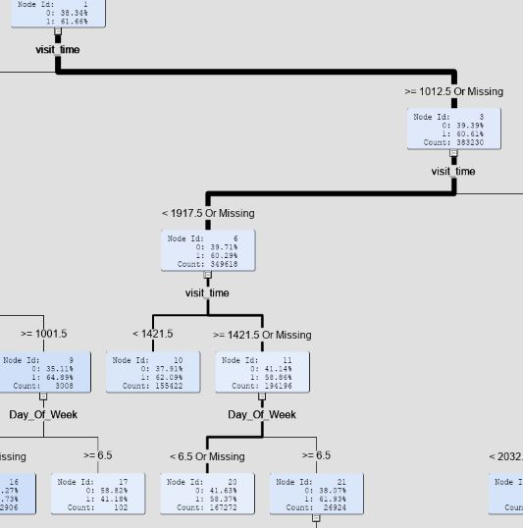
Decision Tree 2
Effect of the day of the week and time of day on whether a big purchase was made
Misclassification rate of about 38%
In general, big purchases occurred in the middle of the day between 10am and 7pm
Day of the week mattered more for purchases after 2pm -- on Sunday, large purchases typically occur before 6pm
This model could be used to make staffing decisions based on when lots of large purchases tend to be made

Slide 7
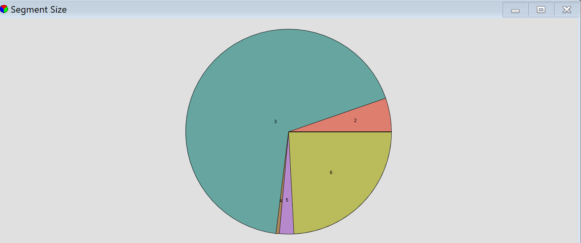
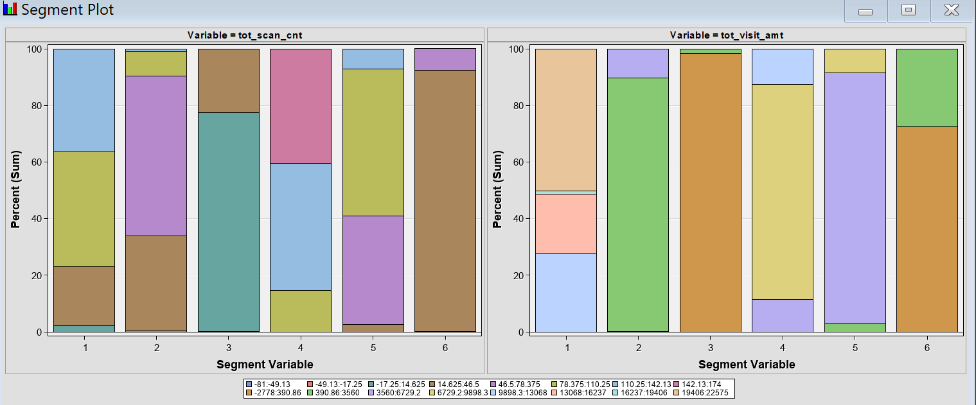
Cluster Analysis
Based on the mean statistics that resulted from the cluster analysis there were no mean returns on the items bought.
The biggest segment is segment 3 with 9.53 items with the amount of $105
The second largest segment is segment 6.
Segment 6 consisted of 30 items in a cart totaling to around $389
Delete from mystorebeer where order dept_nbr = 99
Segment 1 contained large amounts of cigarette purchases

Slide 8
Cluster recommendations
Based on the cluster analysis it would be beneficial to put more emphasis on the low priced items as its the most abundant segment.
The mid-ranged market is lower than the rest so marketing in the sector could bring in new sales and customers.

Slide 9
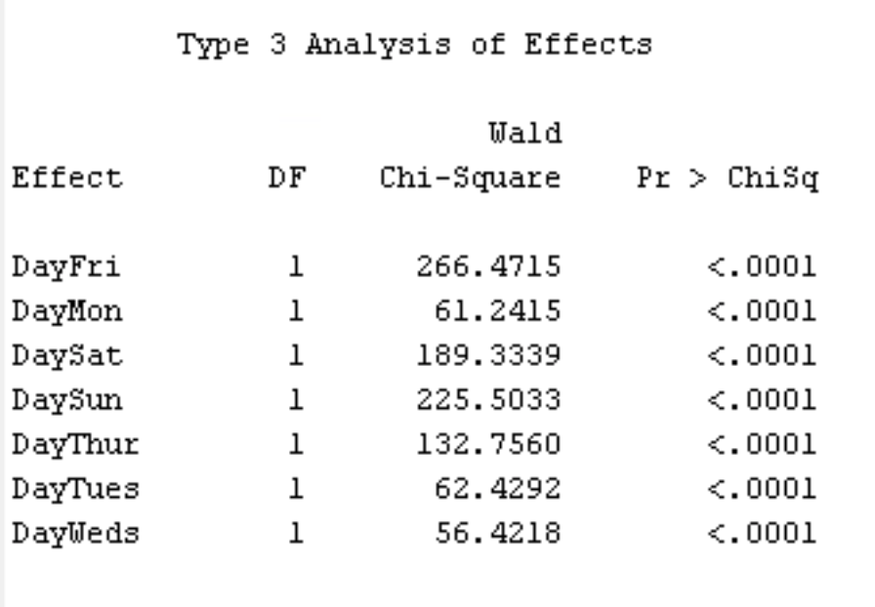
Regression Analysis
The days of the week with the higher chi-square value have the highest influence on whether your visit contains beer
We can see that Friday and Sunday have the highest values
The weekend and the days leading up to the weekend have highest values overall
Therefore, Thursday, Friday, Saturday, Sunday have the highest influence on beer purchases

Slide 10
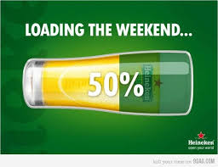
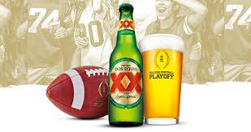
Regression Recommendations
Based on the regression analysis we recommend that the store manager create ads/posters for the store to promote/encourage consumers to buy beer for the weekend
Ad campaigns promoting beer and sunday football games may also be useful
Adding coupons for beer on the weekends to encourage purchases could also increase sales

Slide 11
Thank you for your time!

