Slide 1








TECO
SCAM AWARENESS
By Rachel, Nevine, Corina, Jordan, Zachary, and Alisson

Slide 2


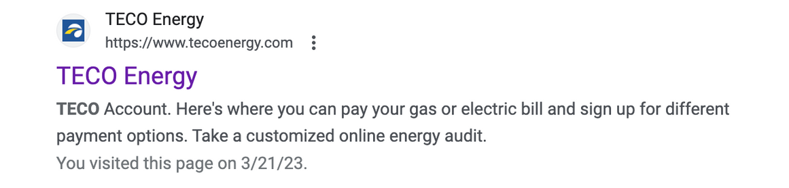
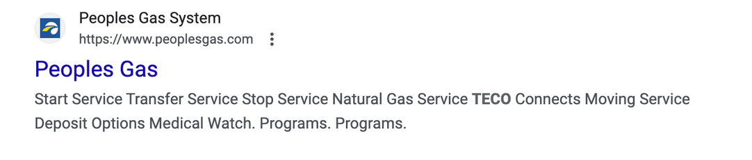
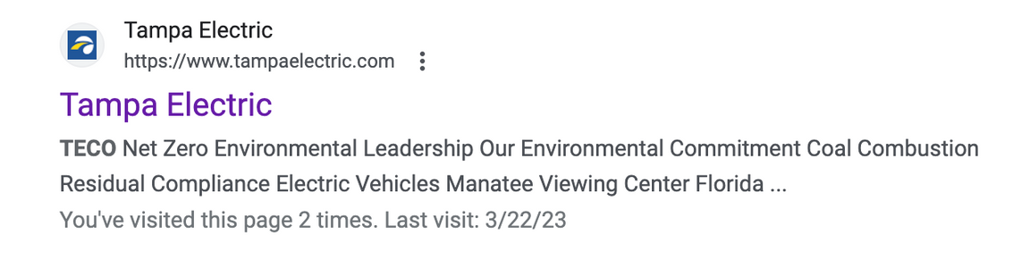
WEBSITE REVIEW
DONE WELL
Design Congruence
Continuance
Information above the fold
Regular updates
AREAS FOR IMPROVEMENT
Multiple main pages
Multiple brand names
"Page" is not an available search filter
Notes:
Rachel

Slide 3


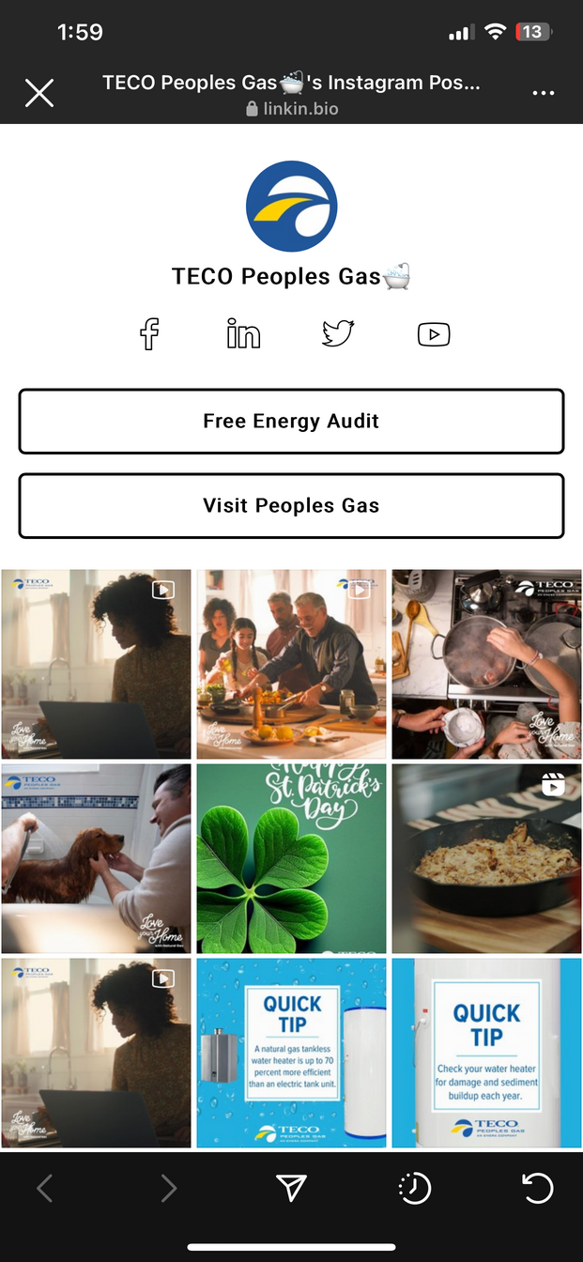
SOCIAL MEDIA REVIEW
ADDITIONAL NOTES
SOCIAL MEDIA
  No App
  Confusing links
  Congruence issues across social media
  Number of Social Media Accounts: Strong presence across multiple social media platforms.
  Activity Level: About 10-15 posts per month
  User Engagement Level: Minimal engagement with almost no comments or shares.
  Congruence: TECO has several different profile names across its social media platforms.
Notes:
Rachel

Slide 4





Website
Email
Global Rank: 218,073
Country Rank: 38,550
Category Rank: 113
Total Visits: 241,400
Average Duration: 1:46
Bounce Rate: 67.03%
Pages per visit: 2.17
Not always mobile friendly
None on the scam awareness
Lack of regulatory information in some emails: unsubscribe/ address
DIGITAL
MARKETING
AUDIT
SEO
Reputation Management
Advertising
Keywords: Teco, Tampa Electric Login
On-page SEO (specifically scam awareness page):
Use of keyword: 4% of all words
No value add or unique value propositions in the paid advertising on Google searches
Most responsive on Facebook and Twitter often responding within 24 hours
Other places such as Google Reviews have no response from the company
Notes:
zack

Slide 5




THE
COMPETITION
  It is one of the largest energy companies in the US.
  Active on Facebook and Instagram, focusing on three main themes: advertising, education, and people and culture.
  On Instagram, Duke Energy posts only images and videos to showcase employees and company culture, renewable energy, and carbon emissions.
  Facebook content focuses on education and advertising, with blog posts generating the least interaction.
  Duke Energy tends to post on weekdays, with higher activity on Mondays, Tuesdays, and Wednesdays.
Notes:
Nevine

Slide 6





SWOT
STRENGTHS
WEAKNESSES
  Social media presence
  Homepage on website
  Blog post
  Website pages
  Website search bar
  Mobile-friendliness
  Emails
  Social media engagement
OPPORTUNITIES
THREATS
  Increase engagement on social media.
  Send more emails, or possibly send out email notifications about campaigns.
  Adapt emails to fit mobile style.
  Create a mobile app.
  Data Security
  Economic downturns
  Evolving social media algorithms
Notes:
alisson

Slide 7


OUR
MARKETING
PLAN
Notes:
Alisson (brief introduction to our plan)

Slide 8


PROTECT YOUR INFORMATION
  PROTECT YOUR POWER

Slide 9



SMART
GOALS
1
2
Increase social media engagement on Instagram and Facebook by 10% within two weeks by posting tips, resources, and informational content on how to stay safe from scammers.
Increase email open rates by 10% and click-through rates by 5% within two weeks by sending out newsletters with tips, resources, and informational content on how to stay safe from scammers.
Notes:
Nevine

Slide 10

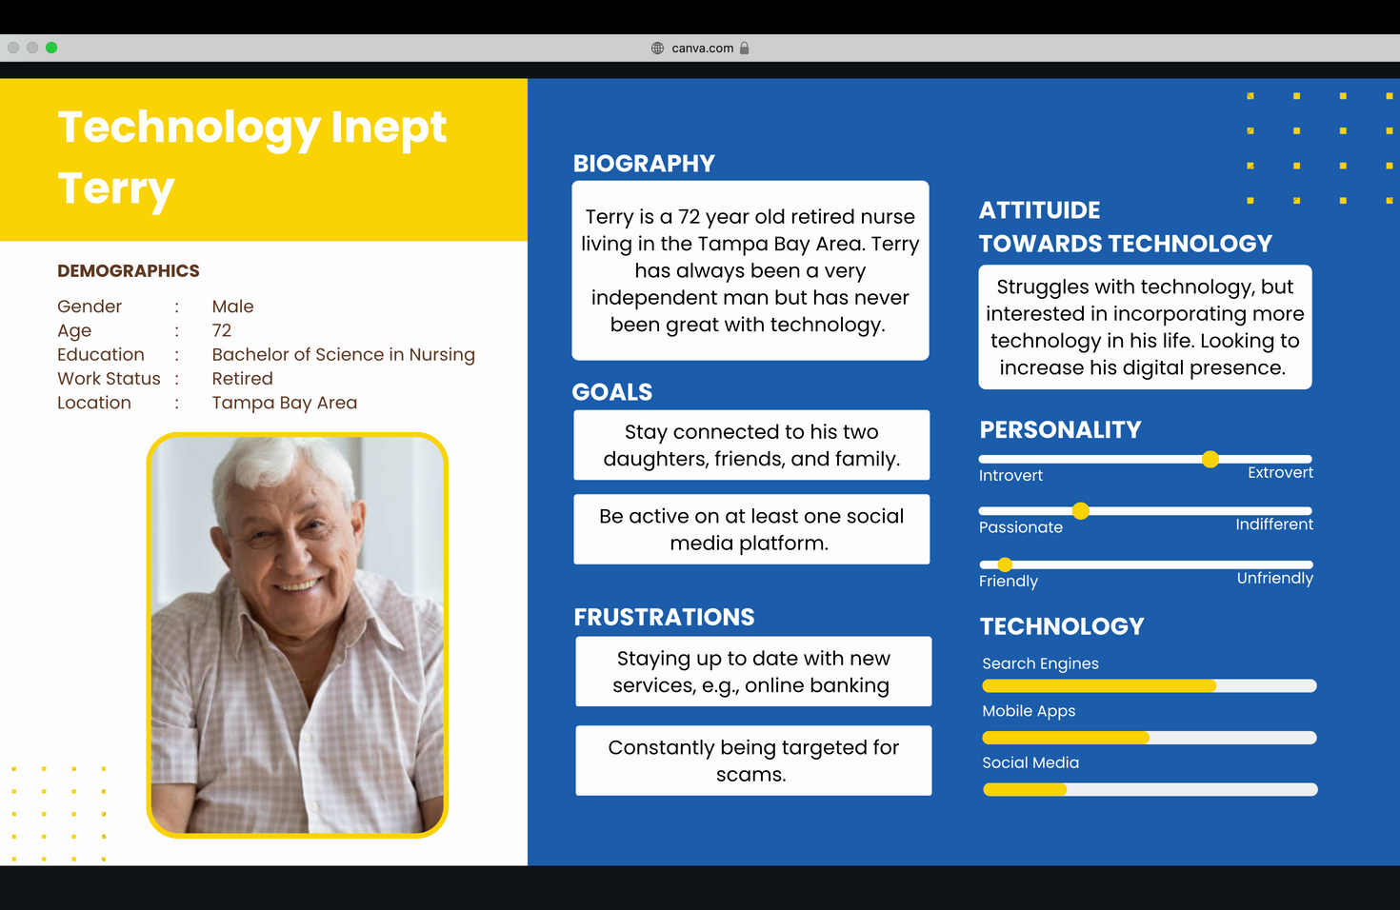
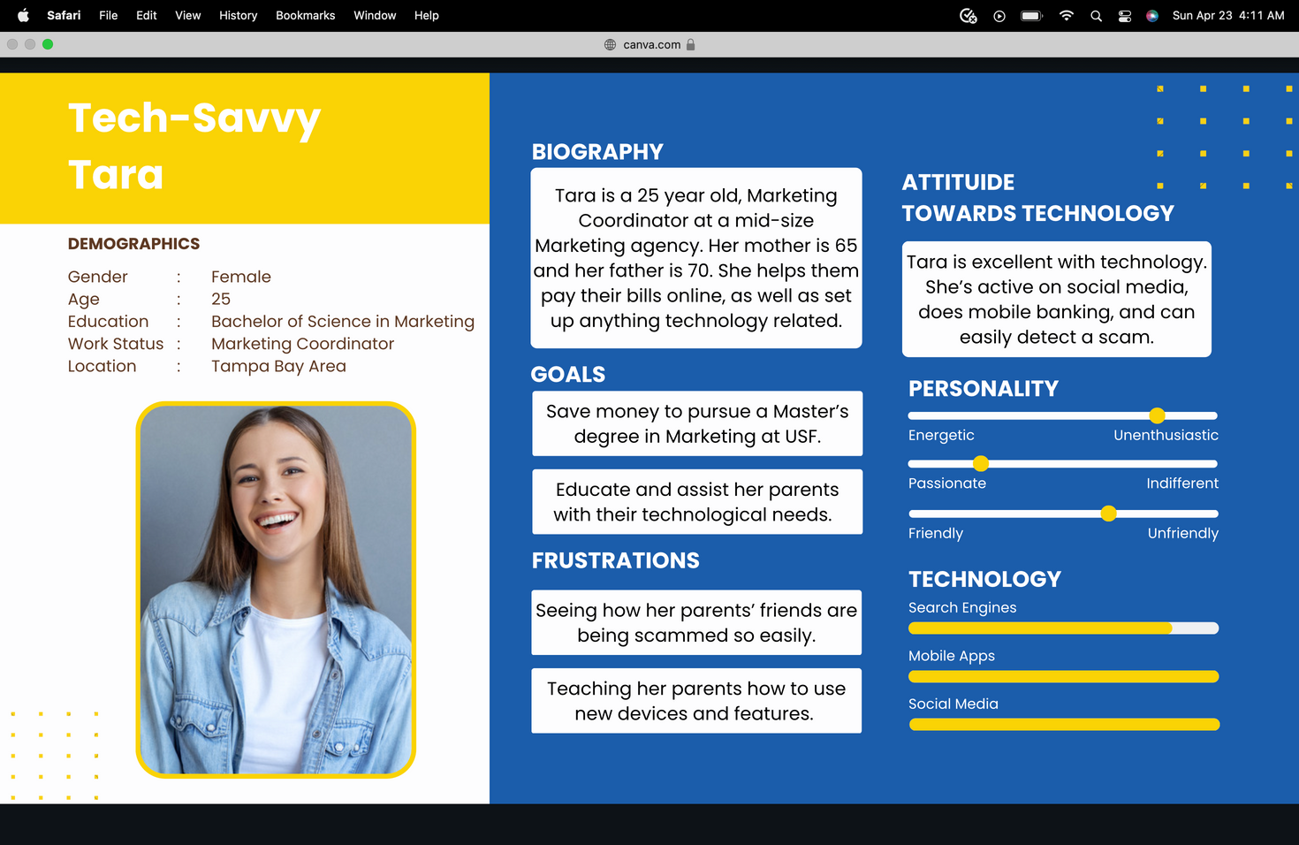
CUSTOMER PERSONAS
Notes:
Corina

Slide 11


ESTIMATED COST
KEY METRICS
Labor: $3,100 (if salaried employees)
Hubspot subscription: $400
Semrush subscription: $250
Google Analytics: Free
Total: $3,750
Likes
Comments
Followers
Shares
Website Traffic
Click through rate
Scam reports
Unique Opens
Notes:
zack

Slide 12
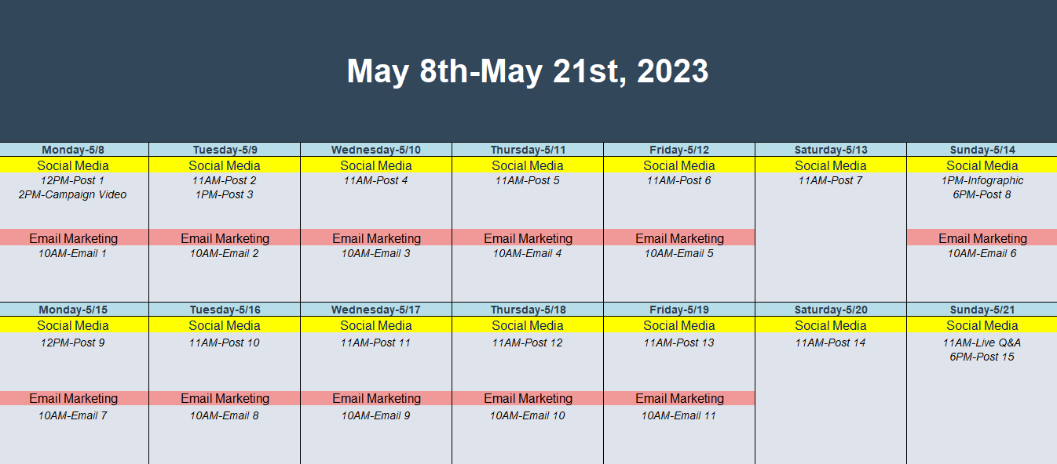
CONTENT CALENDAR
Notes:
Jordan

Slide 13

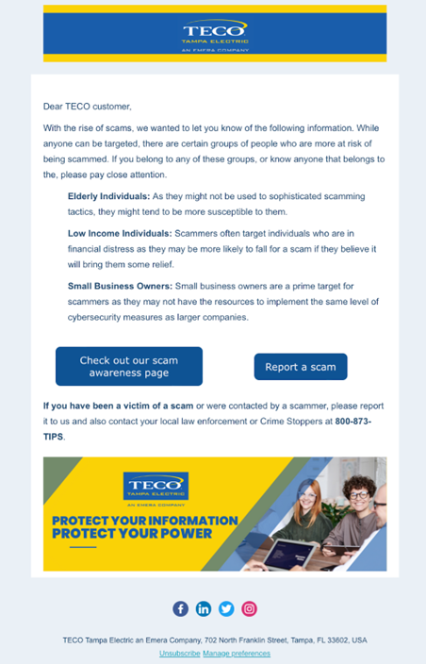
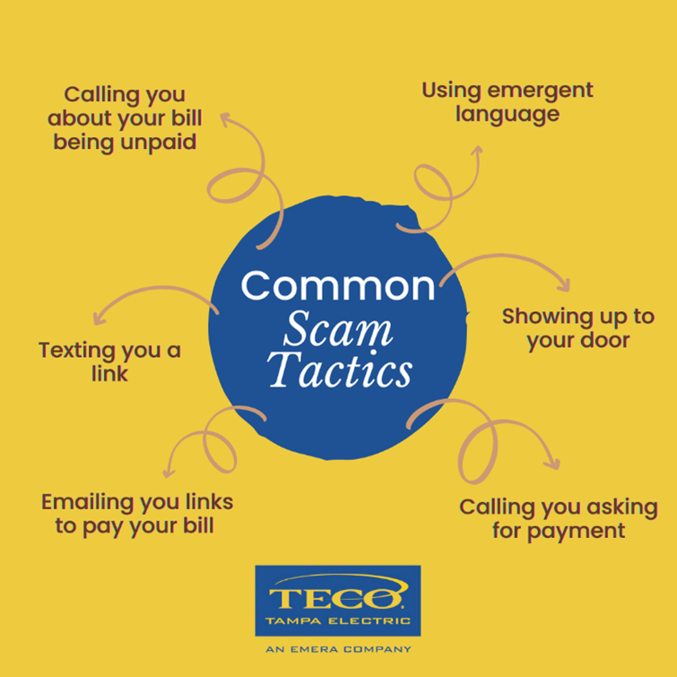


CONTENT SAMPLES
EMAIL MARKETING
SOCIAL MEDIA POST
CAMPAIGN VIDEO
Click here for video

