Slide 1
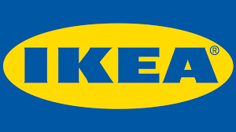
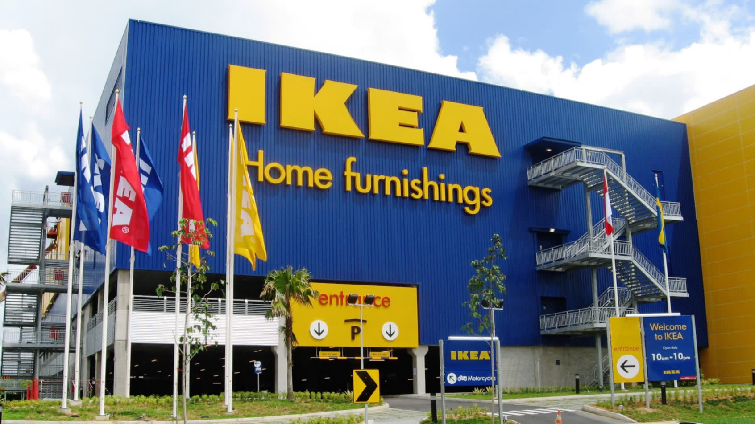
IKEA Slowly Expands Its U.S. Market Presence
Rachel, Mary, Hannah, Dyllan,

Slide 2
Case Summary
Key issues
Analysis
Internal & External
Agenda
Recommendations
Implementations
Expected outcome
Conclusions

Slide 3
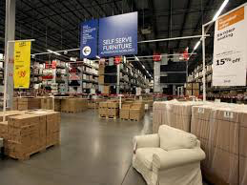
Case Summary
Founded in 1943 by Ingvar Kamprad
IKEA is known for its low-cost, and economical principals
IKEA Concept: “provide functional, well-designed furniture at prices so low that as many people as possible will be able to afford them. Creating a better everyday life for the many people”
World’s largest retailer for furniture
IKEA needs to find a better way to expand their business into the U.S by adapting to the needs of Americans
Notes:
Hannah

Slide 4
Key Issues
2 Key issues in regards to U.S expansion:
Adapting their products and services to different areas around the U.S who have different tastes
Americans view do-it yourself assembly as low quality, but Americans demand quality with their products
Notes:
Hannah

Slide 5
Internal Analysis
Resources Has over 360 stores in 45 countries and 147,000 employees | Competitive Advantage Cost, it is very affordable place to buy furniture Product differentiation
Capabilities Efficient and localized production | Core Competencies Low cost business model Built strong brand awareness through customer satisfaction
Notes:
Resources: over 360 stores, 147000 employees, 51 stores in North America
Competitive adv: very cost effective. not expensive at all to buy nice things from their stores, many different products. you can buy desks, tables, sofas, but also silverware, rugs, plants, and toys, so there is a wide range of products.
Capabilities: efficient production, localized it, so they were able to increase production capacity and producing high quality products at lowest costs, they can also provide suppliers financial assistance if needed
Core competencies: low cost business model, Flat-pack, you can easily transport it and fit it into your car and the assembly is very easy, unique product designs and makes it easy for anyone to shop, destination shopping, they made their stores in the US a fun place to go where you can do other things than just shop. You can eat, get face painted, birthday parties etc

Slide 6
Internal Analysis
V
R
O
I
COST
YES
YES
NO
YES
Temporary Competitive Advantage
Product differentiation
YES
YES
NO
YES
Temporary Competitive Advantage
Notes:
V: it is valuable because of their low-cost business strategy. They are sustainable, cost effective which allows them to be profitable.
they offer so many different products in store, have food, child care, so many things that make it valuable
R: it is rare because they offer such low prices and the store is set up in a such a unique way because from every point of the store you can see every detail, they have fun activities planned for the month, food etc
I: it could be imitated. although, the business model is great and low cost, with the right company of resources, they could do the same thing to make their products cheaper, easy to pack and assemble. you can copy their style too, eventually everyone with tight resources can do this
O: successful in many countries, have been around for a long time and continuing to grow. have a strong brand (everyone knows them for their prices, style, product offerings, fun spaces) which they can use to market themselves even more and a reason why they are so successful.

Slide 7
External Analysis
Political | IKEA operates in just 23 U.S. states, six of which have right-to-work laws. Implication: This could complicate IKEA’s expansion efforts.
Environment | Consumers are interested in “green” products, that are good for the environment Implication: Loss of customers to other companies with more “green” furniture products .
Social | American IKEA customers bought European style vases and used them as drinking glasses, as they were too small for vases. Implication: Losing customers due to the fact that their products are more geared towards Europeans.
Technology | Ease of online shopping Implication: Customers can access more through the internet and compare prices of competitors more easily.
Economic | Its penetration of the U.S. market has been hampered by a weakened economy and the inconsistency between the traditional U.S. furniture market and IKEA’s low-cost operating philosophy Implication: Changing economy could lead to people not buying as much furniture and therefore less people buying from IKEA.
Legal | This past year, IKEA was hit with its 5th lawsuit in just over a year in the U.SZ. courts. Implication: Customer’s could see IKEA as a tempermental company and may not want to shop with them anymore.

Slide 8
External Analysis
Porter’s 5 Forces:
The threat of competitors: Low
There aren’t really any other companies just like IKEA
The threat of new entry: Low
There isn’t a high threat from competitors or any other companies.
The power of buyers: High
U.S. consumers are very picky when it comes to the products they are purchasing
The power of suppliers: Low
IKEA has a lot of suppliers to choose from
The threat of substitutes: High
There are a lot of furniture companies that may have more appealing options than IKEA.
Notes:
The threat of competitors: There aren’t really any other companies like Ikea in the U.S. There are companies like wayfair, target, and Amazon, but they do not have the same main focus of IKEA.
The threat of new entry: Low because there isn’t a high threat of competitors
The power of buyers: U.S. consumers are very picky when it comes to the products they are purchasing
The power of suppliers: Low because IKEA has a lot of suppliers to choose from, so IKEA more has the power as opposed to the suppliers
The threat of substitutes: Although there aren’t any companies that are specifically just like IKEA there are a lot of furniture companies that consumers can chose over IKEA. These companies may have more appealing options such as a less overwhelming showroom and the fact that you do not have to build the furniture yourself.

Slide 9
Marketing Mix
Product | Do-It-Yourself Furniture
Promotion | Printed Catalog IKEA App Word-Of-Mouth Special Events (Birthday Parties, Fundraising, etc.) Traditional Television, Internet, Radio
Place | Southeast U.S. expanding to the Midwest
Price | Low-cost

Slide 10
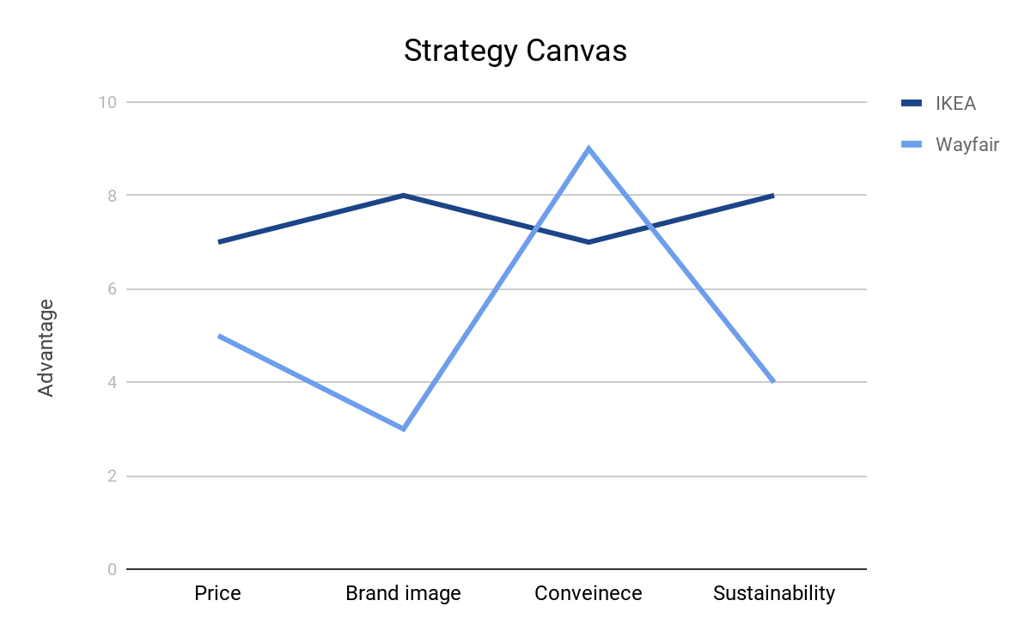
Strategy Canvas

Slide 11
SWOT
Strengths Low-Cost Structure = 9 Corporate Structure = 6 Do-It-Yourself Approach = 4 Added Amenities = 9 Brand Image = 6 Strong focus on Sustainability = 6 | Weaknesses Do-It-Yourself Approach = 4 Limited Customization = 4 Limited Promotional Expenditures = 4 Weak Online Support = 6
Opportunities Economic Conditions = 6 Demand for Convenience = 9 Popularity of Stylish, but Sustainable, Products | Threats Competition = 9 Changing Customer Needs/Tastes = 6 Mature Market Preferences = 6
= 6
Strategic Effort: Aggressive due to large amount of strengths and opportunities

Slide 12
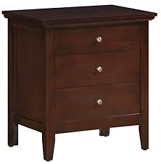
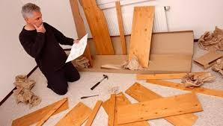
Recommendations
Offer furniture that is already assembled along with the assemble yourself furniture
Notes:
To accomodate Americans who think that assemble yourself furniture is cheap. Having already assembled furniture options can be geared towards those people

Slide 13



Recommendations
Increase advertising in the US markets through social media and television
More advertisements on instagram
Notes:
-in european markets, they have a lot of commercials but they are considered to be more offensive than what Americans like to see on TV,
-TV: have commercials where they highlight their food, big space, and what each store is doing per month
ex: San Fran store does kids birthday parties, ATL store does something for college kids. advertise those more because their brand is all about customer satisfaction
-social media presence: increase their advertising on instagram, twitter, other social media sites by paying for more sponsored posts and using influencers more to show what they got and how great it is

Slide 14
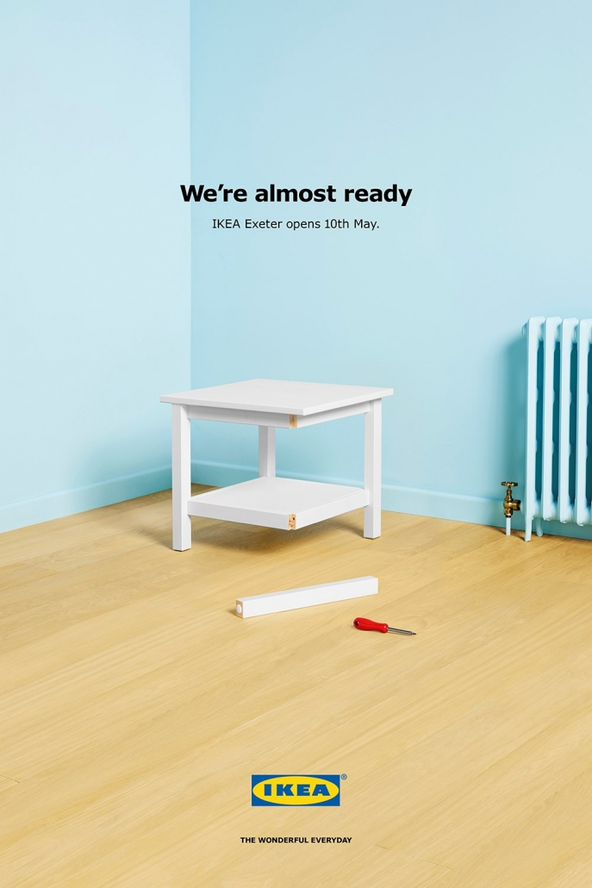
Implementations
Cost: $300,000
Time Plan: 12 months
Have at least 3 of each furniture already assembled in the back in order to give customers that option
  IKEA offers service to have someone come and put together the piece of furniture, so having already assembled pieces is a good middle ground so customers don’t have to take an extra step
Step 1:
Update storage room to accommodate for more assembled furniture
Step 2: Advertise in stores that already assembled furniture is available
Notes:
-Middle ground between the assemble yourself and having someone from IKEA come to your house to assemble to furniture
-time plan is 12 months to make sure the warehouse has been updated to keep all the inventory, and 2 months to advertise it in stores

Slide 15
Implementations
Cost: $500,000
Time Plan: 6-8 months
Have more commercials about the fun things they do in their stores
Increase the amount they pay for sponsored posts to show up on people’s feeds
Hire more instagram influencers to share what they purchased to reach more people
Step 1: Hire outside advertising agency to help come up and produce content
Step 2: Find the right time to post about new events and new product offerings
Notes:
-cost 500,000 because it will take a good amount of money to hire an outside firm to help with the new commercials and analyze the right times to post

Slide 16
Implementation
Timeline
 | 2019 | 2020 | 2021 | 2022
Build pre-assembled furniture for customers
Begin selling assembled furniture
Find popular Instagramers
Look for best instagram content and posting times
Have instagramers advertise IKEA pre-assembled products

Slide 17
Expected Outcome
By implementing our recommendations IKEA should see:
  Increase in sales by 10-15%
  Increase in millennial presence and purchases by 6-8%
  Increase in revenue of $1,000,000
    400 new customers X $2,500 per sale=$1,000,000 in revenue
Notes:
-More options for assembly leads to increase in sales
-More social media presence leads to increase in millennial interactions

Slide 18
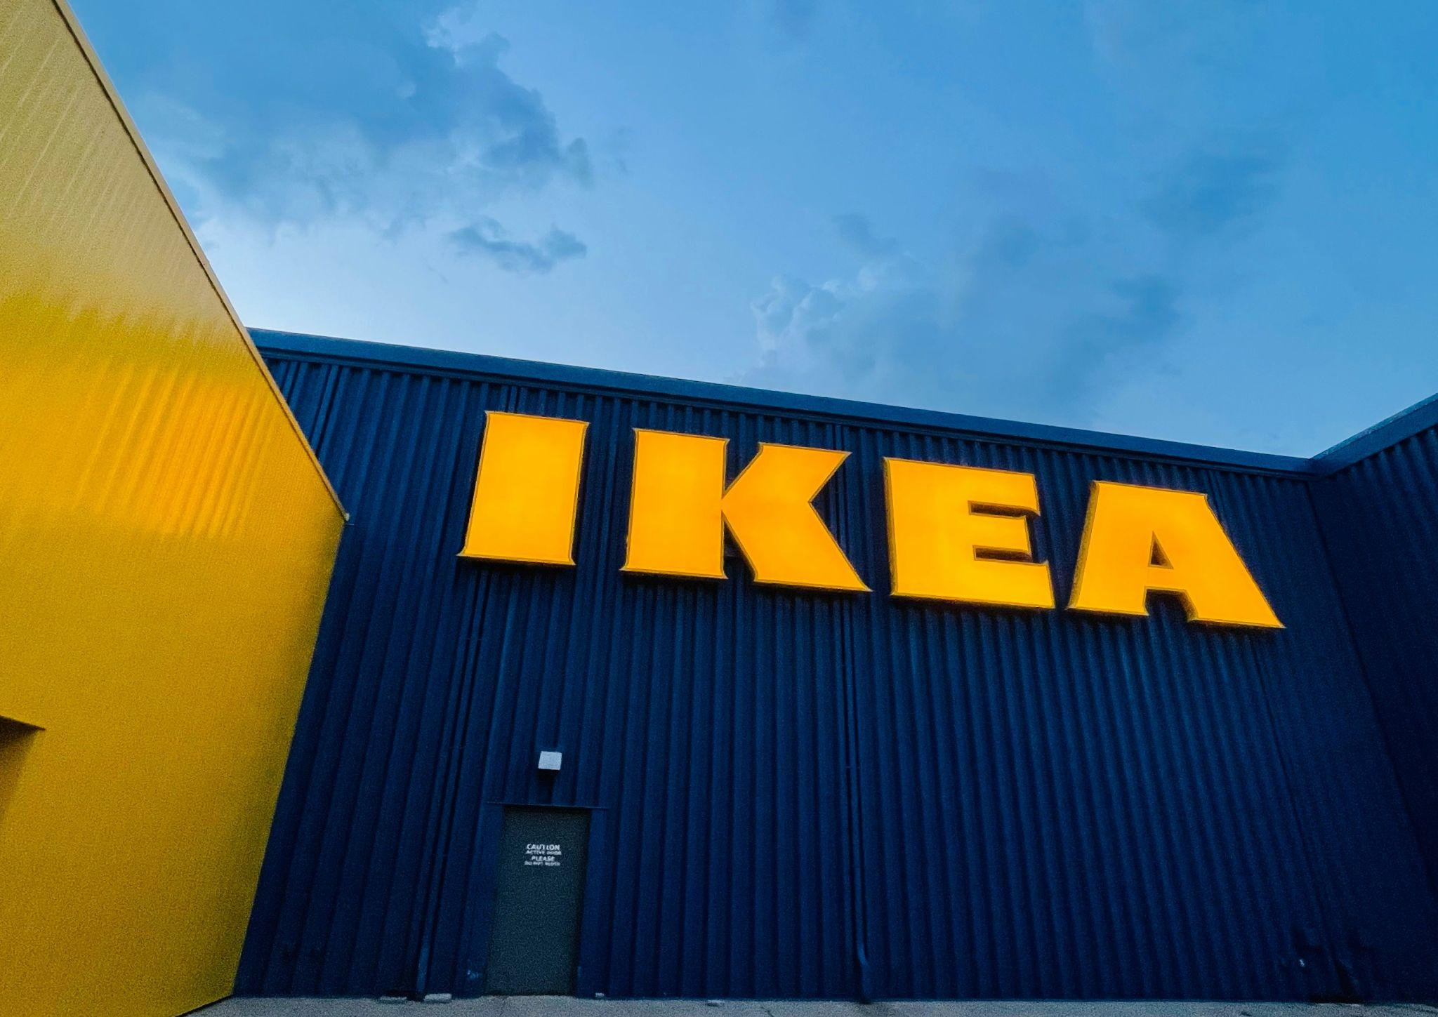
Conclusion

